Slide 1



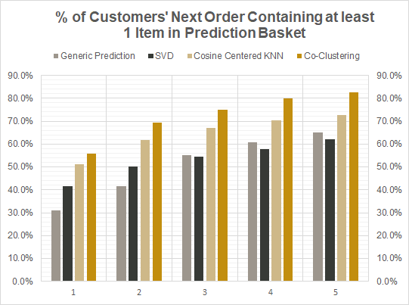
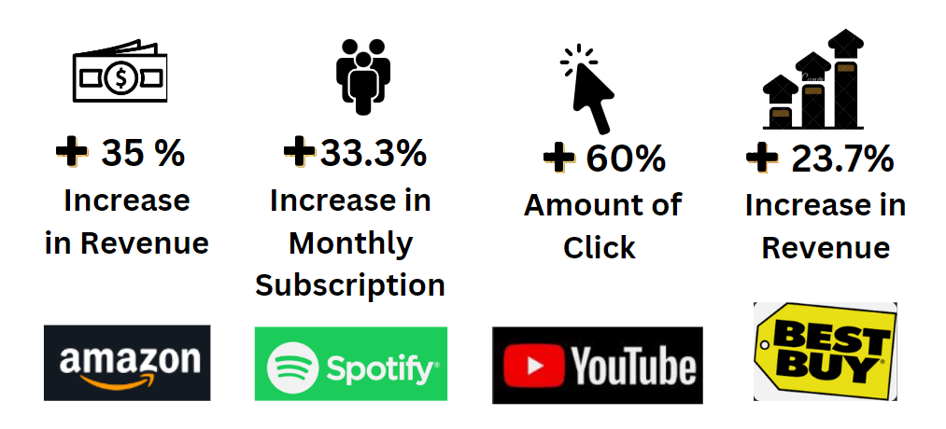









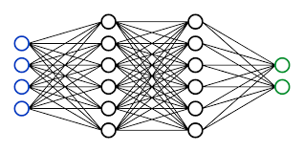
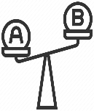
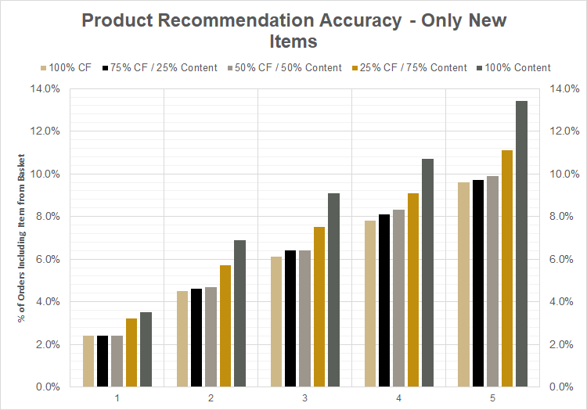




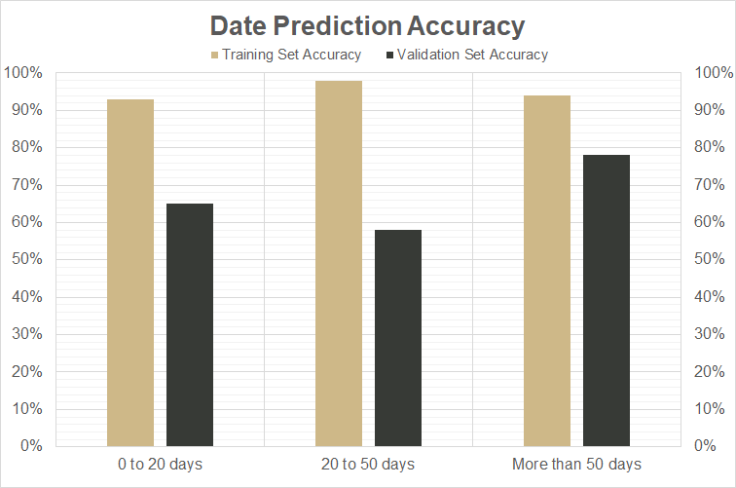
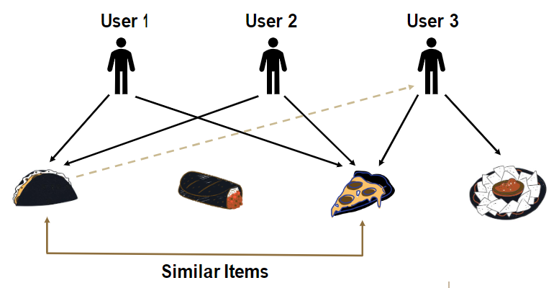





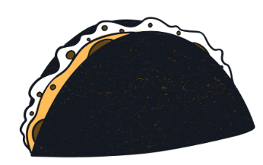
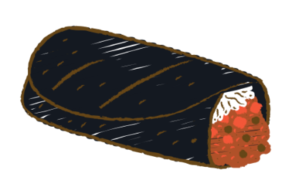

Made-to-Order: Targeted Marketing in Fast-Food Using Collaborative Filtering
Oluwayemisi Ajayi, Yuqiu Chen, Jason Crawford, Kamalika Das, Venkata Rahul Karumuri, Matthew A. Lanham
Purdue University, Mitchell E. Daniels, Jr. School of Business
ajayi4@purdue.edu; chen3485@purdue.edu; crawf136@purdue.edu; das192@purdue.edu; vkarumur@purdue.edu; lanhamm@purdue.edu
BUSINESS PROBLEM FRAMING
DATA
MODEL BUILDING
BUSINESS IMPACT ASSESSMENT
In a crowded market of fast-food chains, it's essential to stand out and appeal to customers better than the competition. One way to achieve this is by showing the customers are cared for and a more personalized experience them feel valued. Research indicates 54% of retailers claimed that product recommendations act as the key driver of the AOV (average order value) in customer purchase (Skovhøj, 2022). This study enables to accurately predict when and what a customer will order next allowing this food brand to target and cluster users more granularly results in following benefits:
Feature Priority:
Relationship between customers and products
Date difference between orders
Sample set is one year of transaction of transactions for 25,000 customers
Orders bucketed by customer and item used in model to determine likelihood of ordering both previously seen and unseen items
USER - 25K
Training Data
Q1-Q3 transactions
Prediction Data
Q4 transactions
To translate the effect of increased prediction accuracy on conversion rates and per-order spending, the below A/B test presents customers with one of two advertisements: one informed by the personalized customer prediction baskets and one for the brand’s most popular products across users nationwide
ORDERS - 700K over full year
DATE + TIME
PRODUCT - 1.2M
Improvement Areas
- Penalize previously recommended products not ordered
RANDOMIZATION UNIT
PRICE
QUANTITY
MODIFICATIONS
Alternate weeks of a Month
Order Conversion
Avg. Order Price
Campaign Wastage
Baskets of n products predicted to be in the users’ next order based on % order inclusion (actual for previously ordered items or predicted per collaborative filtering for unordered products).
TREATMENT GROUP
CONTROL GROUP
Campaign shown with products in prediction basket
Fig. 4. Data structure
Shown current national campaign advertisement
METHODOLOGY
Software
Libraries
Fig 6. Product prediction basket model accuracy
s
Python
Co-Clustering Prediction: at least one item in a customer’s
next order in 75% of the test set with a basket of 3 items vs 51% generically
predicting the company’s most popular items to all users
OUTCOME METRIC
Fig. 1 Recommendation algorithm significance statistics
Data Preprocessing
Modeling
ORDER Conversion Rate
Average Order Price
Data
Collaborative filtering is more accurate in predicting items from entire product universe
Content-based approach 1.5x more accurate than collaborative filtering at predicting basket of previously unordered items (across all recommendation basket sizes 1-5)
ANALYTIC PROBLEM FRAMING
Raw Data
EDA
Increase the conversion rate of customers and improve customer life cycle
for the fast-food chain factoring the varying buying pattern from a vast pool of customers. Assuming, the sample transactional data reflects the fast-food entire customer persona and buying patterns accurately, the recommendation model built in this study successfully
Training Data
Data Partition
Test Data
Data Cleaning
Modeling
Model
Comparison
Hybrid model generates predicted inclusion rates for unordered products
NULL HYPOTHESIS (H₀)
ALTERNATE HYPOTHESIS (H_{a})
µ_{Before}= µ_{After}
µ_{Before} < µ_{After}
1.Buckets users based on their potential next visit day
2. Predicting >=1 item of the bucket of products in the customer's next order
Collaborative Filtering
Content-Based
Fig 9. A/B testing to measure business efficacy
CONCLUSIONS
Product Prediction
Calculate product inclusion rate for each customer
Co-Clustering
K-Means
GOAL : Predict When and What a Customer will Order Next
Collaborative Filtering
Captures implicit/unseen relationships
Higher accuracy when generating basket including previously ordered items
More conservative in predicting new items
Content-based Filtering
Explicitly captures similarities between items
Higher accuracy when predicting unseen items
More aggressive in predictions
METHOD : Collaborative Filtering and K-Means Clustering
Basket of top n products by inclusion rate
(actual or predicted)
FILTER CUSTOMERS IN BUCKET
GENERATE PREDICTED % ORDER INCLUSION
Fig 7. Collaborative & content filtering predicting new items
SOURCE DATA
<20 Days
Classification model most accurate at predicting those in cluster ordering >50 days in future
Training on Q1-Q3 transaction history
Prediction designed to parse customers likely ordering in the few weeks
User-Transaction
RECIPIENTS OF TARGETED MARKETING CAMPAIGN
FILTER TOP X CUSTOMERS BY PRODUCT INCLUSION %
Create independent variables
- Recency
- Frequency
- Monetary
- Date difference in purchases
- Mean and standard deviation of Date difference
K-means to formulate clusters
<20Days
20-50 Days
>50 Days
Date Prediction
Classification Model
Order Conversion
Avg. Order Price
Campaign Wastage
RFC
XGBOOST
Improvement Areas
- Retain accuracy while creating more granular clusters
Fig 10. Use case of model
Beef Taco
Beef Burrito
Fig. 5. Overall Model methodology
ACKNOWLEDGEMENTS
Fig. 2. Collaborative filtering
Fig. 3. Content based filtering
Fig 8. Date prediction clustering accuracy
Gratitude to Professor Matthew Lanham and our industry partner for this opportunity, their guidance, and support on this project.

